Slide 1

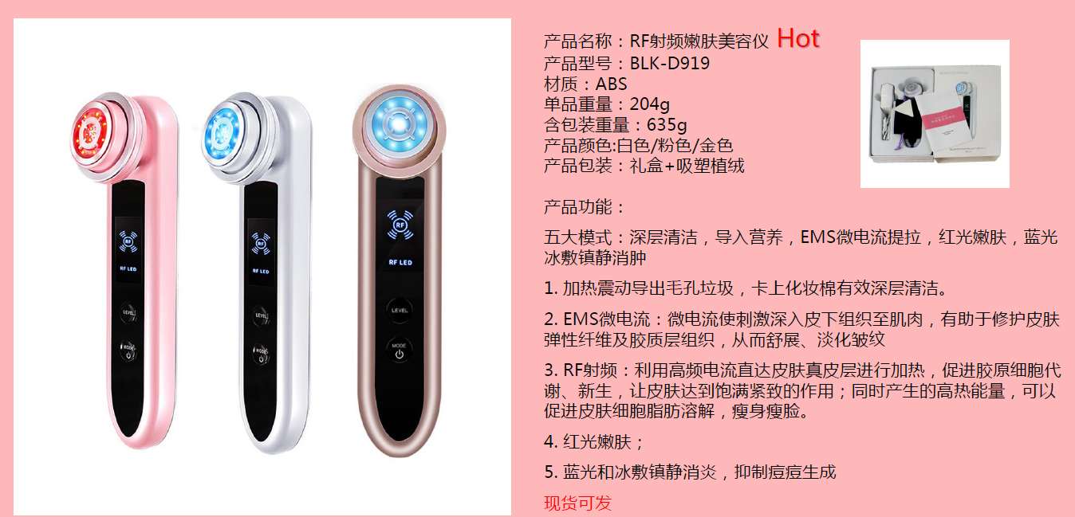

Slide 2
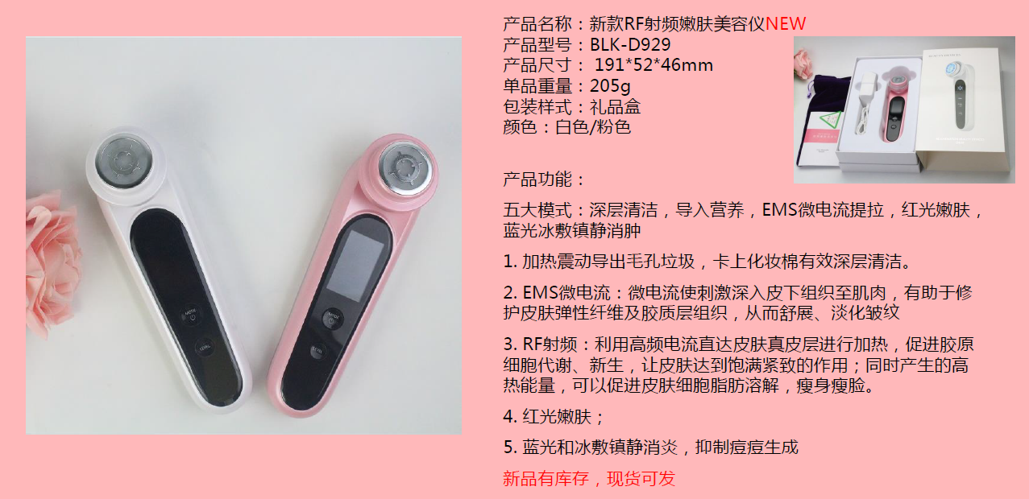

Slide 3
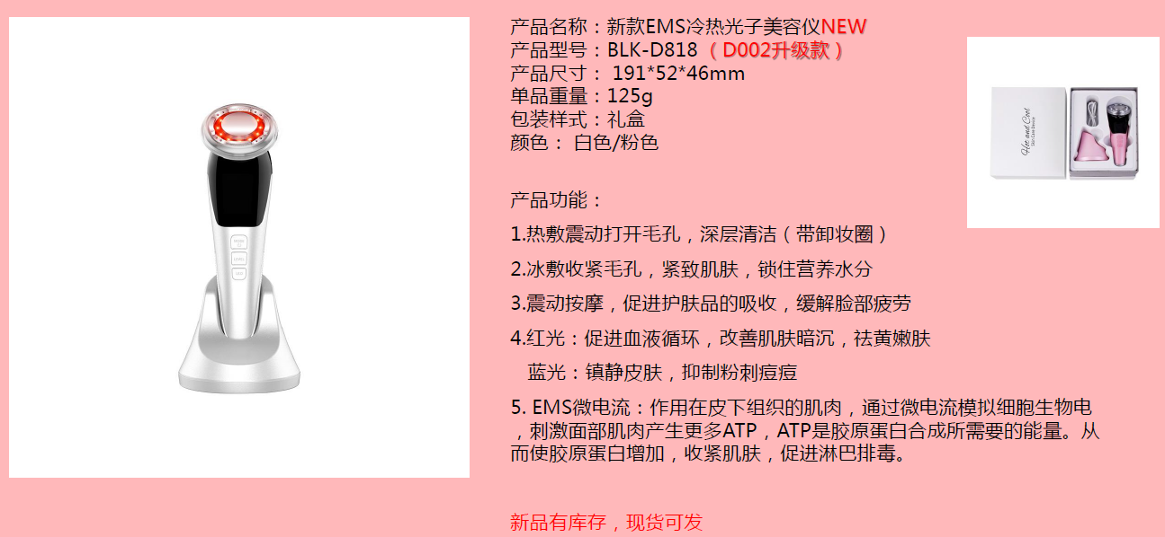

Slide 4
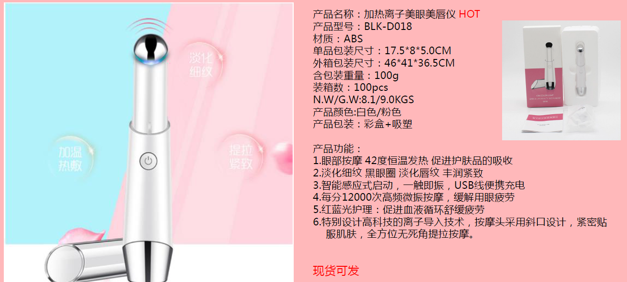

Slide 5
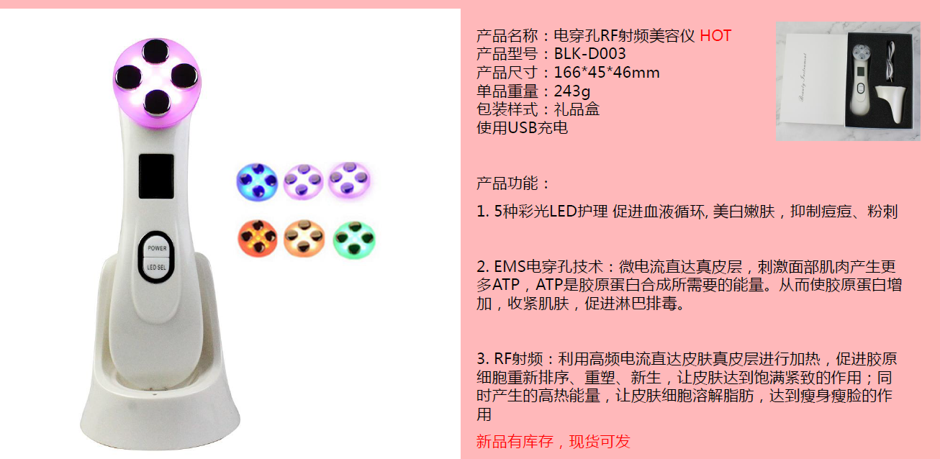

Slide 6
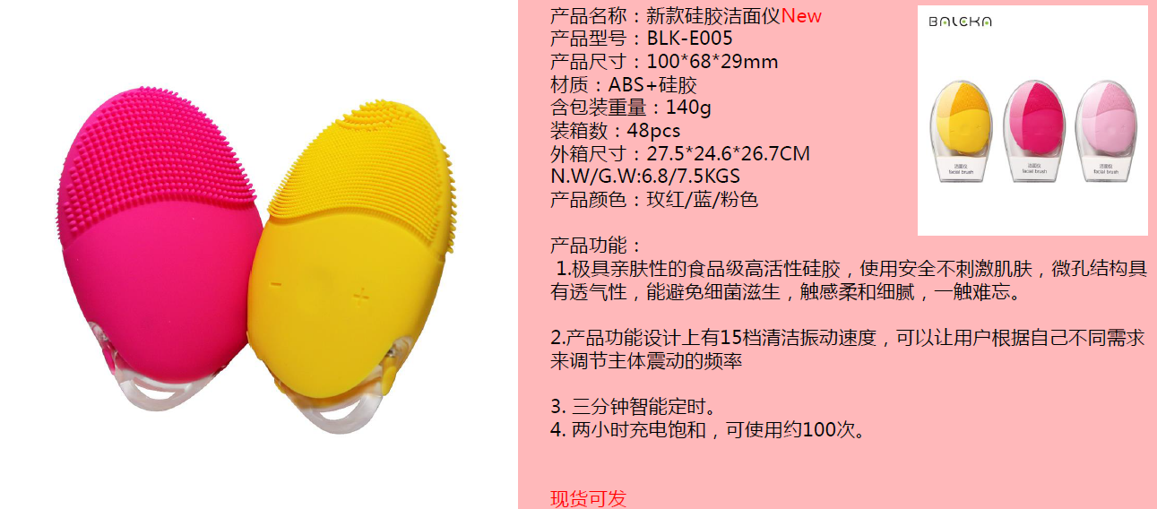

Slide 7


Slide 8
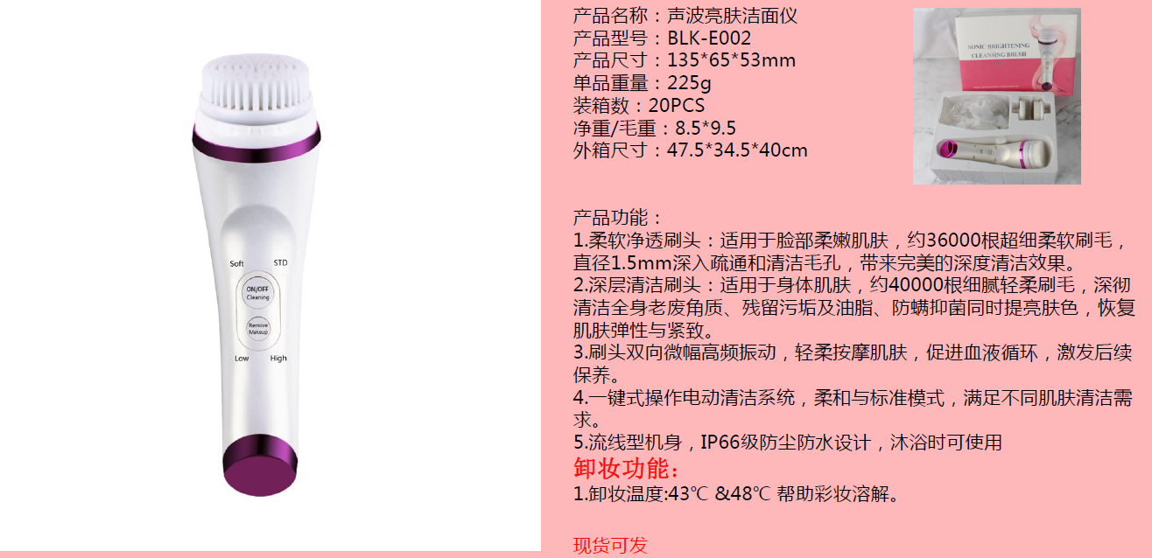

Slide 9


Slide 10
THANKS FOR YOUR KIND ATTENTION !
FOR ANY NEW INQUIRY , PLS FEEL FREE TO CONTACT US BELOW.
Contact person: Natalie Wang
Tel: +86-755-26604116
Fax: +86-755-82773634
Mobile: +86 136 3258 3500
Emial: natalie@estonasia.com

